Slide 1
Geometry - Introduction
Broad-phase Collision Detection
Programming – Maths for Games

Slide 2
Contents
Collision Detection
Two-phase Collision Detection
Bounding Volumes

Slide 3
Collision Detection
Collision Detection is a field of mathematics dedicated to determining when two shapes overlap
Volume Intersection
It is used in physical simulations, triggering logical events in games, managing spatial relationships, determining object visibility and many more tasks
Some algorithms are accurate, providing intricate details about the object overlap
Others are fast

Slide 4

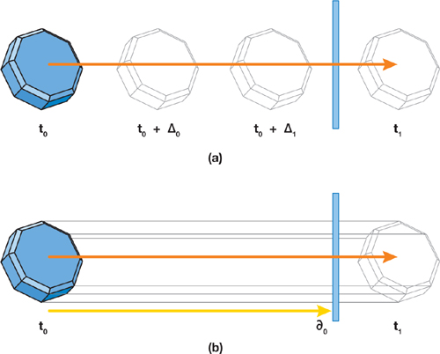
Collision Detection
Accurate algorithms tend to be slow
In 2D, we could check the location of each pixel of a sprite against each pixel of every other sprite
In 3D, we could check the location of each polygon (triangle, or face) of a mesh against each polygon of every other mesh
In a physical simulation, we should consider dynamics, such as movement, to avoid phasing through objects
Improvements are always being made, but it’s best to avoid ‘perfect’ collision detection
Simpler algorithms and simpler volumes are preferred for speed, rather than accuracy
Notes:
Not completely avoid, just hide it as much as possible.

Slide 5
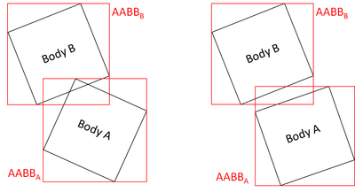
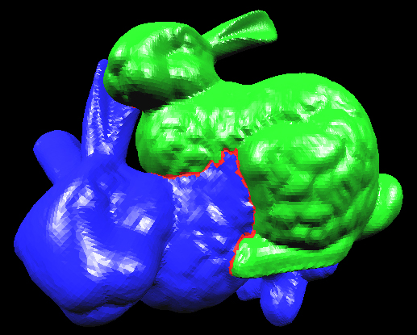
Two-phase Collision Detection
Collision detection systems are usually arranged into two or more phases
Broad-Phase
Quick and dirty early-out boolean check using simple Bounding Volumes to see if further tests are required
Narrow-Phase
More thorough calculation to determine precise overlap information
Typically using more complex volumes like hulls or polytopes
Notes:
Sometimes there’s an additional suite of various mid-phases.

Slide 6
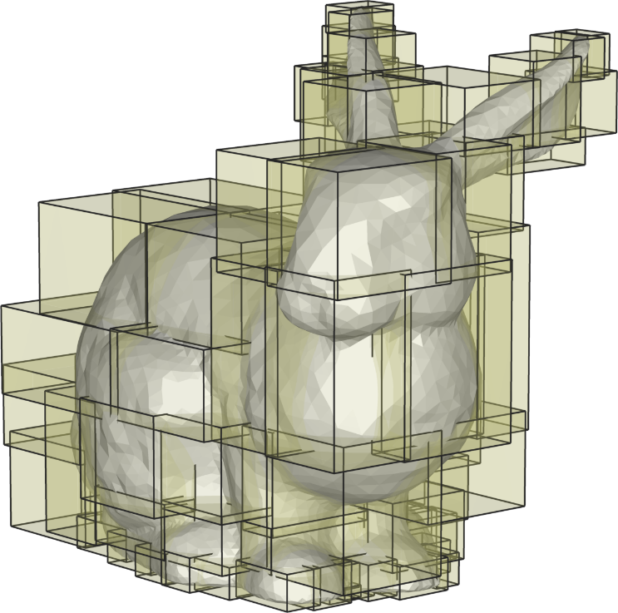
Bounding Volumes
Simplifying the geometry speeds up the calculations
Complex objects or ideas can be represented as a composition or hierarchy of Bounding Volumes
Algorithms exist to ‘wrap’ objects into groups of simple bounding volumes
Pass or Fail algorithms involve less math

Slide 7
Bounding Volumes
AABB
Capsule
Bounding Volumes are commonly used shapes for volumes and queries:
Circles and Spheres
Capsules or Swept-Circles/Spheres
Axis Aligned Bounding Boxes (AABB)
Ellipsoids
Oriented Bound Boxes (OBB)
Lines, Line Segments and Rays
Planes
Lots of different shapes to compare!
These are most useful for broad-phase collision detection
Algorithms are similar in 2D and 3D
Circle
Ellipsoid
Plane
OBB
Ray

Slide 8
Bounding Volume Queries
Also important to consider that not all collision detection involves game objects
Some are just queries
Ray-Casting
Casting a line between two points, checking if it intersects anything
Plane or Boundary Crossing
Are we in front of or behind a boundary?
Is this object within the view of a camera?
Hypothetical or Temporal Tests
What all will be affected within this explosion’s radius?

Slide 9
Summary
Collision Detection is used to test for overlap between objects
Broad-phase Collision Detection compares simple geometric shapes that have fast algorithms that trade off accuracy for speed
Complex objects are encased in Bounding Volumes that are used for the simply tests
Narrow-phase Collision Detection attempts to more accurately find the point of overlap and intersection between objects
Typically performed after a Broad-phase test has determined that the two objects might be overlapping
We will look into Bounding Volumes and Narrow-phase techniques in further sessions

Slide 10
Further Reading
Dunn, F, Parberry, I, 2011, 3D Math Primer For Graphics And Game Development, 2nd Edition, CRC Press
Lengyel, E, 2012, Mathematics for 3D Game Programming and Computer Graphics, 3rd Edition, CENGAGE Learning

